Slide 1

B-Trees
© 2013 Goodrich, Tamassia, Goldwasser
B-Trees
Notes:
Dictionaries

Slide 2


Computer Memory
In order to implement any data structure on an actual computer, we need to use computer memory.
Computer memory is organized into a sequence of words, each of which typically consists of 4, 8, or 16 bytes (depending on the computer).
These memory words are numbered from 0 to N −1, where N is the number of memory words available to the computer.
The number associated with each memory word is known as its memory address.
© 2013 Goodrich, Tamassia, Goldwasser
B-Trees

Slide 3
Disk Blocks
Consider the problem of maintaining a large collection of items that does not fit in main memory, such as a typical database.
In this context, we refer to the external memory is divided into blocks, which we call disk blocks.
The transfer of a block between external memory and primary memory is a disk transfer or I/O.
There is a great time difference that exists between main memory accesses and disk accesses
Thus, we want to minimize the number of disk transfers needed to perform a query or update. We refer to this count as the I/O complexity of the algorithm involved.
© 2013 Goodrich, Tamassia, Goldwasser
B-Trees

Slide 4
(a,b) Trees
To reduce the number of external-memory accesses when searching, we can represent a map using a multiway search tree.
This approach gives rise to a generalization of the (2,4) tree data structure known as the (a,b) tree.
An (a,b) tree is a multiway search tree such that each node has between a and b children and stores between a − 1 and b − 1 entries.
By setting the parameters a and b appropriately with respect to the size of disk blocks, we can derive a data structure that achieves good external-memory performance.
© 2013 Goodrich, Tamassia, Goldwasser
B-Trees

Slide 5
Definition
An (a,b) tree, where parameters a and b are integers such that 2 ≤ a ≤ (b+1)/2, is a multiway search tree T with the following additional restrictions:
Size Property: Each internal node has at least a children, unless it is the root, and has at most b children.
Depth Property: All the external nodes have the same depth.
© 2013 Goodrich, Tamassia, Goldwasser
B-Trees

Slide 6
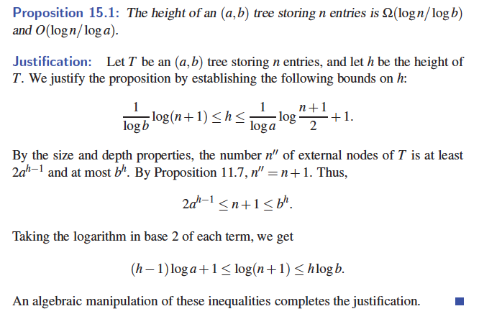
Height of an (a,b) Tree
© 2013 Goodrich, Tamassia, Goldwasser
B-Trees

Slide 7
Searches and Updates
The search algorithm in an (a,b) tree is exactly like the one for multiway search trees.
The insertion algorithm for an (a,b) tree is similar to that for a (2,4) tree.
  An overflow occurs when an entry is inserted into a b-node w, which becomes an illegal (b+1)-node.
  To remedy an overflow, we split node w by moving the median entry of w into the parent of w and replacing w with a (b+1)/2-node w and a (b+1)/2-node w.
Removing an entry from an (a,b) tree is similar to what was done for (2,4) trees.
  An underflow occurs when a key is removed from an a-node w, distinct from the root, which causes w to become an (a−1)-node.
  To remedy an underflow, we perform a transfer with a sibling of w that is not an a-node or we perform a fusion of w with a sibling that is an a-node.
© 2013 Goodrich, Tamassia, Goldwasser
B-Trees

Slide 8
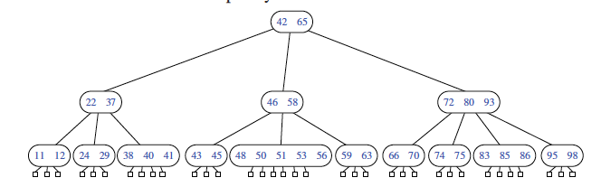
B-Trees
A version of the (a,b) tree data structure, which is the best-known method for maintaining a map in external memory, is a “B-tree.”
A B-tree of order d is an (a,b) tree with a = d/2 and b = d.
© 2013 Goodrich, Tamassia, Goldwasser
B-Trees

Slide 9

I/O Complexity
Proof:
  Each time we access a node to perform a search or an update operation, we need only perform a single disk transfer.
  Each search or update requires that we examine at most O(1) nodes for each level of the tree.
© 2013 Goodrich, Tamassia, Goldwasser
B-Trees

